Slide 1
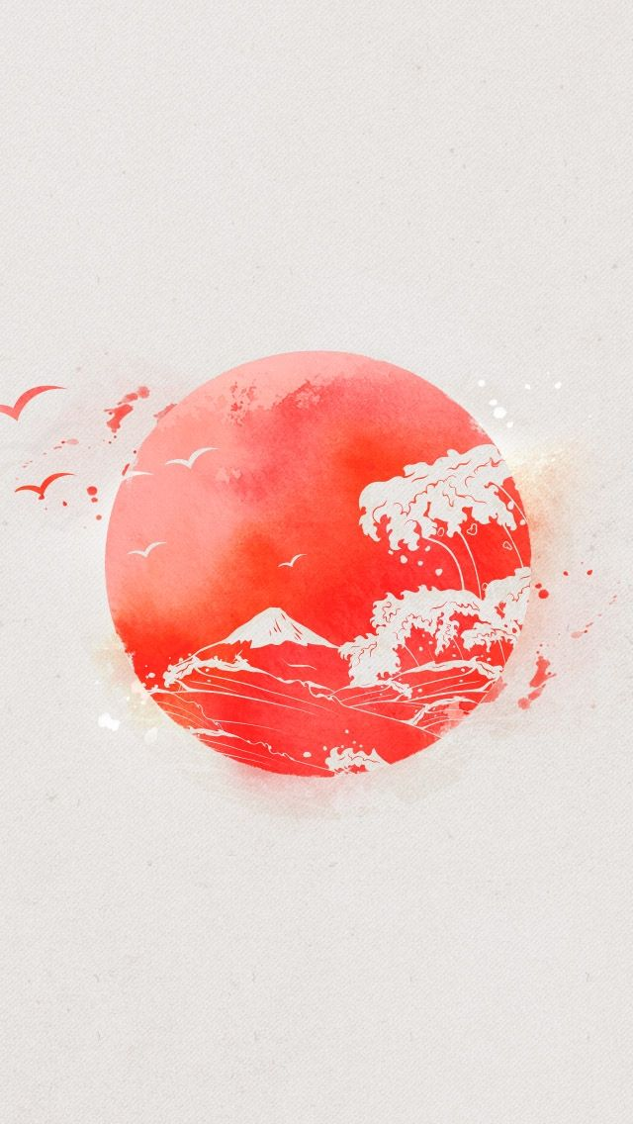
Music & Ideas of Modesty in Japan
Presented by – Arpan Mondal & Ashmitha Das

Slide 2
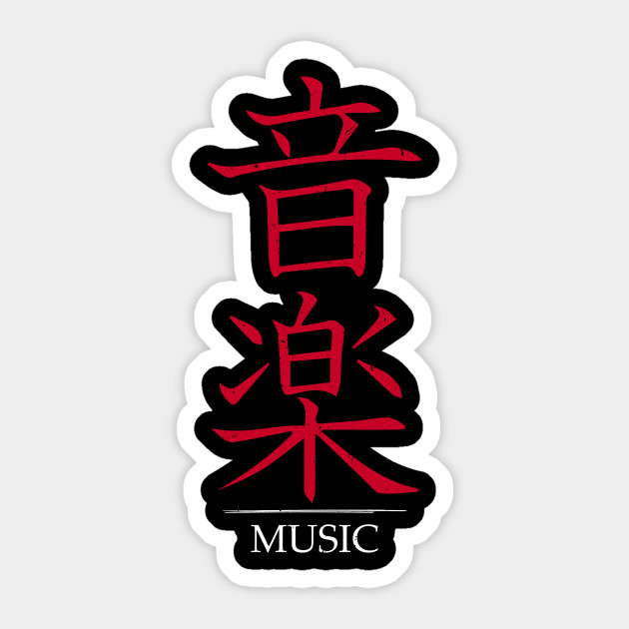
Music of Japan

Slide 3
Introduction
Japan is the largest physical music market in the world, worth US$3 billion in 2014, and the second-largest behind the United States, and the biggest in Asia
Japanese artists, with 37 of the top 50 best-selling albums and 49 of the top 50 best-selling singles in 2014.
Traditional Japanese music differs markedly from Western music, as it is often based on the intervals of human breathing rather than on mathematical timing.

Slide 4
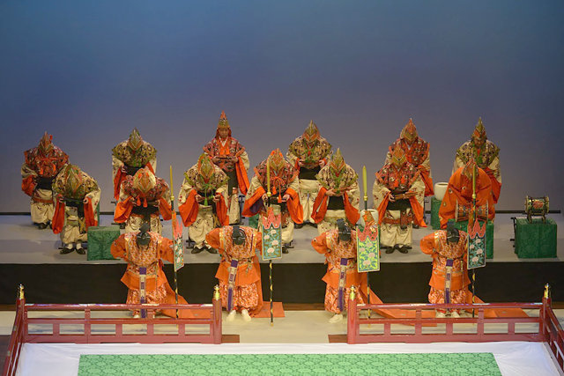
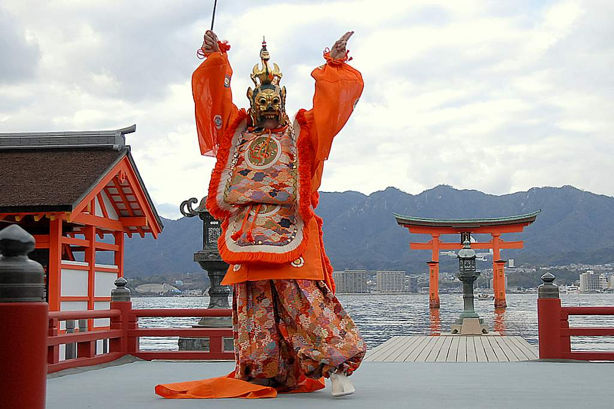
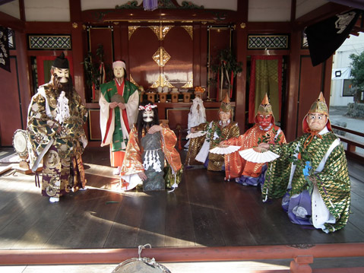
Music
Music = Ongaku /音楽 ( Kanji/音 = Sound & Gaku/楽 = Enjoy)
Traditional and Folk Music
Gagaku (雅楽) = Origin - Heian period. Oldest music.
Kangen = Orchestral Music
Bugaku = Dance Music
Shinto Ceremonies = Only for religious purposes

Slide 5
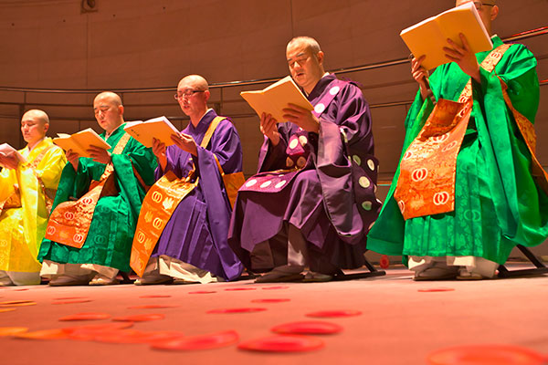
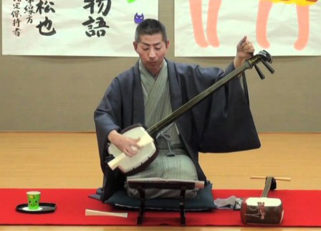
Shomyo (声明 or 聲明) = Buddhist chanting. Origin - India.
Joruri = A narrative music using the shamisen
Gidayu-bushi - During the Edo period, Gidayu began to play joruri in Osaka. This type of joruri is for puppet plays.
Trakiwazu-bushi - Trakiwazu Mojidayu began to play this style of joruri in Edo. This type of juror is for kabuki dances
Kiyomoto-bushi - Kiyomoto Enjyudayu began to play this for kabuki dances in Edo during the late Edo period. He began to play this style in 1814.
Shinnai-bushi - In the middle of the Edo period

Slide 6
Musical Instruments
Biwa
Short-necked
Often used in narrative storytelling
Hyoshigi
Consisting of two pieces of wood connected by a thin ornamental rope.
Used in traditional theaters in Japan to announce the beginning of a performance.
Kane
A type of bell from Japan
Kokyu
The only one played with a bow.
Koto
Koto is the national instrument of Japan
180 centimeters length, and made from kiri wood. 13 strings.
Fue
Fue is the Japanese word for flute
Shakuhachi
Shakuhachi One of the most popular and oldest of the Japanese fue

Slide 7
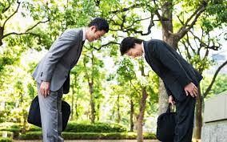
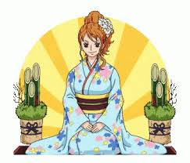
IDEAS Of MODESTY
Greetings are a very important part of Japanese culture.In Japan when two people meet you have to bow and say konnichiwa (Hello). A deeper, longer bow indicates respect and conversely a small nod with the head is casual and
For any kind of meet at home,or at religious occasion,people are expected to sit in the seiza style positioning, in which one sits with their legs tucked directly underneath themselves with a straight back.

Slide 8
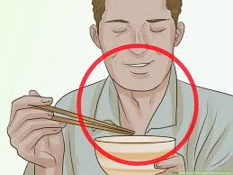

The Japanese are also famous for their fondness for apologizing as an act of courtesy. It often seems their reaction to any situation is to apologize first.
In Japan it is also common when three people meet and two don't know each for there to be no effort to introduce the two who don't know each other.
When eating at a traditional meal, the bowl is held to the mouth to avoid bending down to reach the table.
They rely less on words to convey context and are more attentive to the posture, expression and tone of voice of the speaker to draw meaning from a conversation
Gifts are important in Japan as their quality and choice is reflective of the relationship two people have and the respect the giver wishes to show to the recipient.

Slide 9
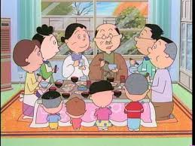
Japanese are highly sensitive to criticism. Great lengths are taken not to criticize someone instead hints are offered in subtle ways.
Working in harmony is viewed as the crucial element for productivity; thus, the Japanese have a predisposition to be indirect, gentle and courteous even if they disagree with what you are saying.
Japanese culture puts heavy emphasis on participation, diligence and performance in people’s professional lives. The workforce is extremely dedicated and there is much pressure to strive for excellence and perfection.
Japanese feel a heightened sense of belonging and loyalty to their family.

Slide 10


